Slide 1
Go The Language That Intentionally Says ”No”
Curtis McLaughlin
August 18th, 2026

Slide 2

What if a language became popular because of the features it refused to add?
Notes:
Quick show of hands: who regularly works with exceptions, inheritance, method overloading, have used dependency injection, or been involved in a code formatting debate with your coworker for more than 15 minutes? (No judgement… unless you’re arguing about quotes in JavaScript)
Perfect. Go doesn’t do most of that… and it already picked a winner in the formatting debate.

Slide 3








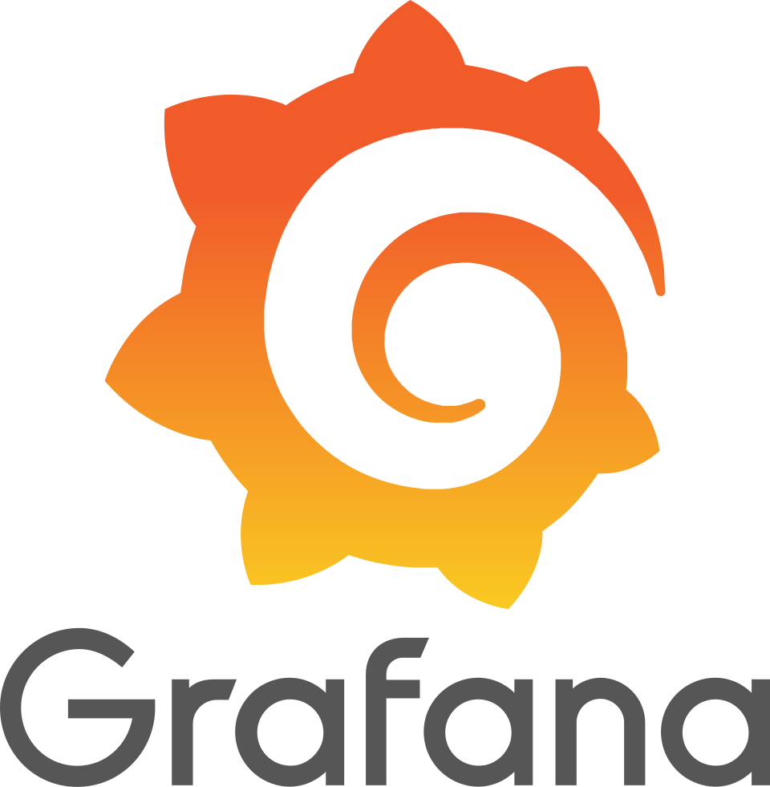




If Go removed all these things that many developers consider essential, why did anyone adopt it?

Slide 4
Why did Google build Go?
Problems
Slow Builds (C++)
Huge Codebases
Complex Abstractions
Difficult Deployments
Concurrency Challenges
Go’s Response
Fast Compilation
Simple Language
Small, Portable Binaries
Built-in Concurrency
Readable Code
Notes:
Before we talk about what Go removed, it’s worth understanding the environment it was created in.
In the mid-to-late 2000s, Google had millions of lines of code, huge developer teams, increasingly distributed systems, and build times that were becoming painful.
Rob Pike, Ken Thompson, and Robert Griesemer saw developers spending too much time waiting for builds, navigating complex abstractions, and managing increasingly large codebases.
The question wasn’t “What features can we add?” it was “What complexity can we remove?”

Slide 5
Go’s Design Rules
Principle | What it means…
Simplicity Wins | Every feature has maintenance cost.
Explicit is Better | Behavior should never surprise you.
Composition Over Hierarchy | Prefer assembling small pieces.
Optimize for Teams | Readability beats cleverness.
Notes:
Everything else in today’s talk is just an example of one of these four principles. Rather than walking through the syntax, we’re going to build a small game. As we build it, we’re going to run into all the things Go intentionally say’s “no” to.

Slide 6
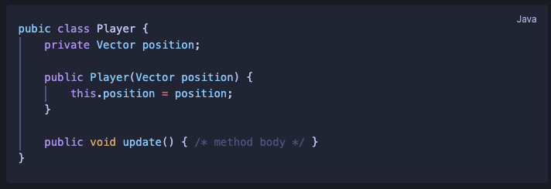
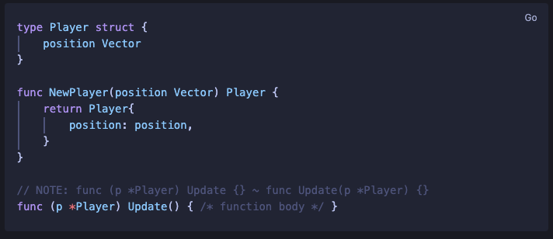
No Classes
Go has structs and methods. No special object construction, no this, no access modifiers
The same Player struct – structure without ritual.
Notes:
Structs hold data. Receiver functions hold behavior.
NewPlayer() is just a regular function, no special syntax.
No public/private - canalization controls visibility outside package.

Slide 7
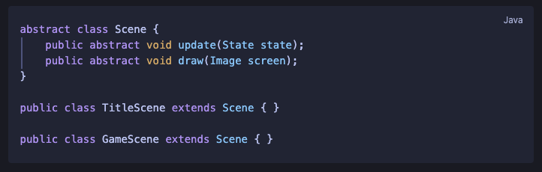
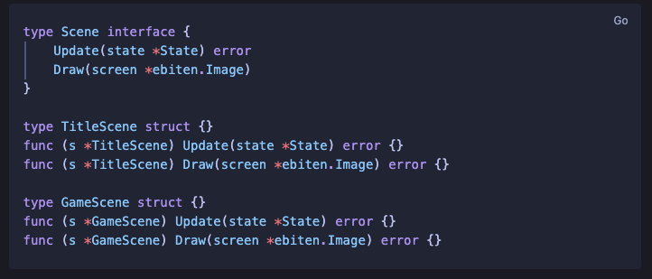
No Inheritance
Go has no extends. Behavior composed through interfaces rather than inherited.
Composition over Inheritance - Go’s own design rule, built-in to the language itself.
Notes:
No parent/child hierarchy – structs satisfy interfaces implicitly
TitleScene and GameScene have no knowledge of each other
SceneManager holds either one via the Scene interface – no casting, no coordination

Slide 8
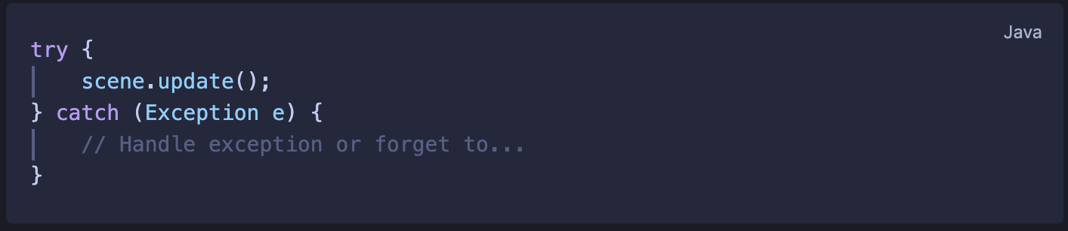
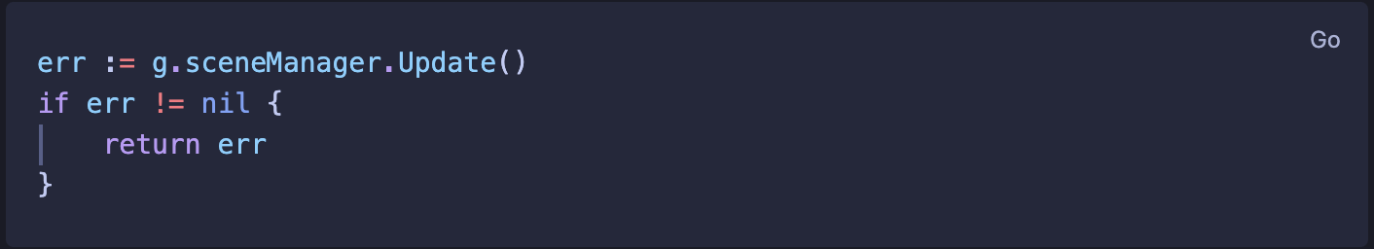
No Exceptions
Go has no try/catch. Errors are just values – returned, checked, and handled explicitly.
Explicit is better – Go’s own design rule, enforced by the language itself.
Notes:
Errors are return values – you can’t ignore them without making a deliberate choice
The call chain is explicit
No hidden control flow – errors travel the same path as any other value

Slide 9
No Formatting Debates
Go ships with a standardized toolchain. gofmt is built in — one format, no configuration, no debate.
Optimize for teams — readability beats cleverness, and consistency beats preference
Notes:
No configuration file — gofmt has no options by design
Code reviews focus on logic, not style
The Asteroids codebase runs gofmt — you didn't choose that, it just is

Slide 10
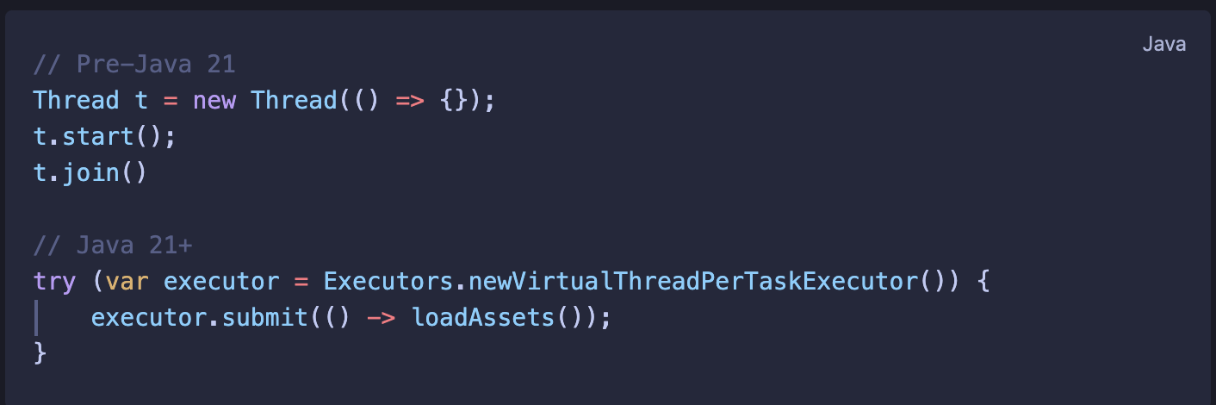
No Threads Required
Go abstracts OS thread management with goroutines — lightweight, cheap, and built into the language.
Built-in concurrency — not bolted on, not a library, part of the language from day one.
Notes:
A goroutine is launched with a single keyword — go
Java 21 virtual threads are a step toward this simplicity — but still need an executor and a submit call
Go's goroutines and channels are a complete concurrency model — not an addition to an older system

Slide 11

Clever Abstractions
Complex Build Systems
Formatting Debates
Heavy Runtimes
Inheritance
Spending Complexity Elsewhere
Readable code
Fast feedback
Team consistency
Simple deployments
Composition
Concurrency

